Slide 1

Adventure Works Cycles

Slide 2





Executive Summary

Slide 3
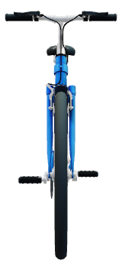

Slide 4
E-Commerce Platform

Slide 5


Slide 6
Road Bikes
Adventure Works Cycles' road bike collection features lightweight, aerodynamic frames and high-performance components, perfect for the avid cyclist.

Slide 7
The company's in-house design team collaborates with engineers to develop innovative bicycle models that meet the needs of diverse riders.

Slide 8
Contact

